Slide 1
UNIT - III
Introduction, Artificial Neuron, Modelling single neuron in Tensor flow, Neural Networks, Conventional Neural Network, Different Layers of CNN, Convolution layer, Pooling Layer, Recurrent Neural Networks, Long short-term Memory, Gated recurrent unit, Encoders, Auto Encoders, Denoising Auto Encoders, Variational Auto Encoders, Popular CNN model

Slide 2
Introduction
The desire to imitate and replicate the intelligence of the human brain by man has been written about over many years; Galatea by Pygmalion of Cyprus in Greek mythology, Golem in Jewish folklore…
Robots with AI are a favorite of (science) fiction writers since time immemorial.
The seminal paper, A Logical Calculus Of The Ideas Immanent In Nervous Activity, in the year 1943 by McCulloch and Pitts proposed the first neural network model—the threshold devices that could perform logical operations such as AND, OR, AND-NOT.

Slide 3
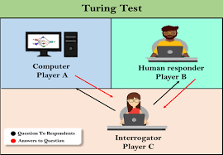
In his pioneering work, Computing Machinery and Intelligence, published in the year 1950, Alan Turing proposed a Turing test; a test to identify whether a machine has intelligence or not. Rosenblatt, in 1957, laid the base for networks that could learn from experience in his report, The Perceptron—a perceiving and recognizing automaton.

Slide 4
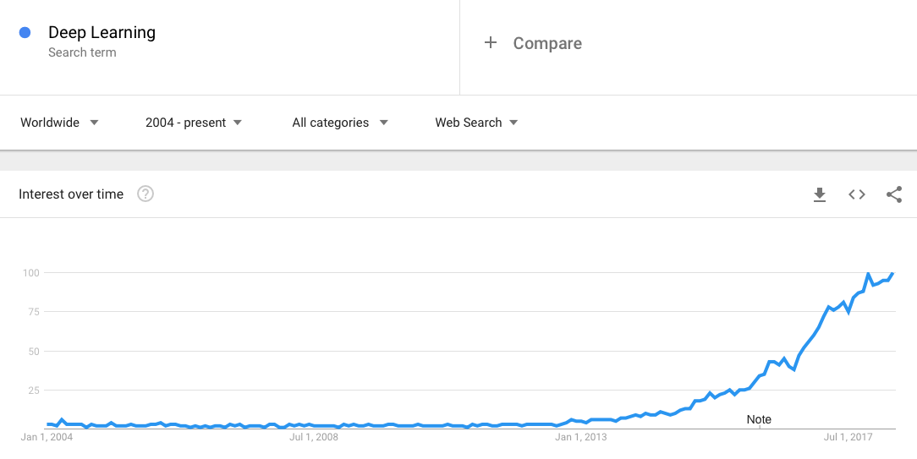
Deep learning in Google Trends from 2004 to April 2018

Slide 5
Deep learning—why now?
Availability of large high-quality dataset:
The internet resulted in the generation of an enormous amount of datasets in terms of images, video, text, and audio.
While most of it's unlabeled, by the effort of many leading researchers (for example, Fei Fei Li creating the ImageNet dataset), we finally have access to large labeled datasets.
Availability of parallel computing using GPU:
In DL models, there are mainly two mathematical matrix operations that play a crucialrole, namely, matrix multiplication and matrix addition.
The possibility of parallelizing these processes for all the neurons in a layer with the help of GPU made it possible to train the DL models inreasonable time.

Slide 6


Slide 7
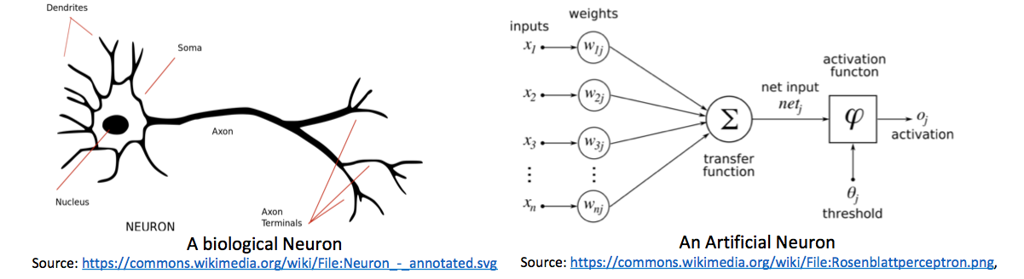
Artificial neuron
The artificial neuron is inspired by the working of biological neurons.
It consists of some inputs connected via weights – Synaptic Connections
The weighted sum of all the inputs goes through a processing function – Activation Function and generates a non-linear output

Slide 8
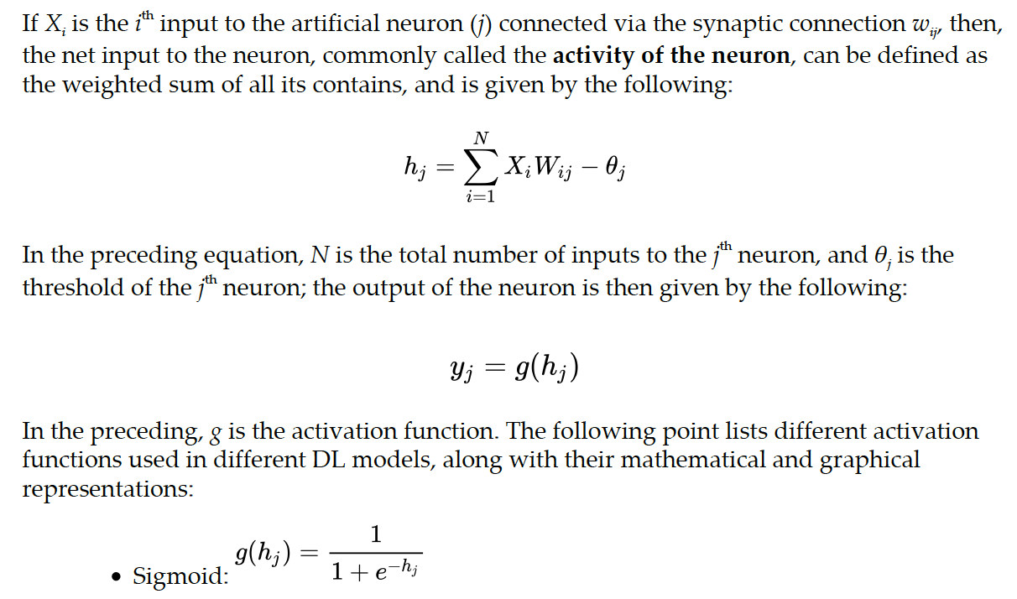

Slide 9
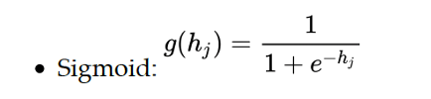
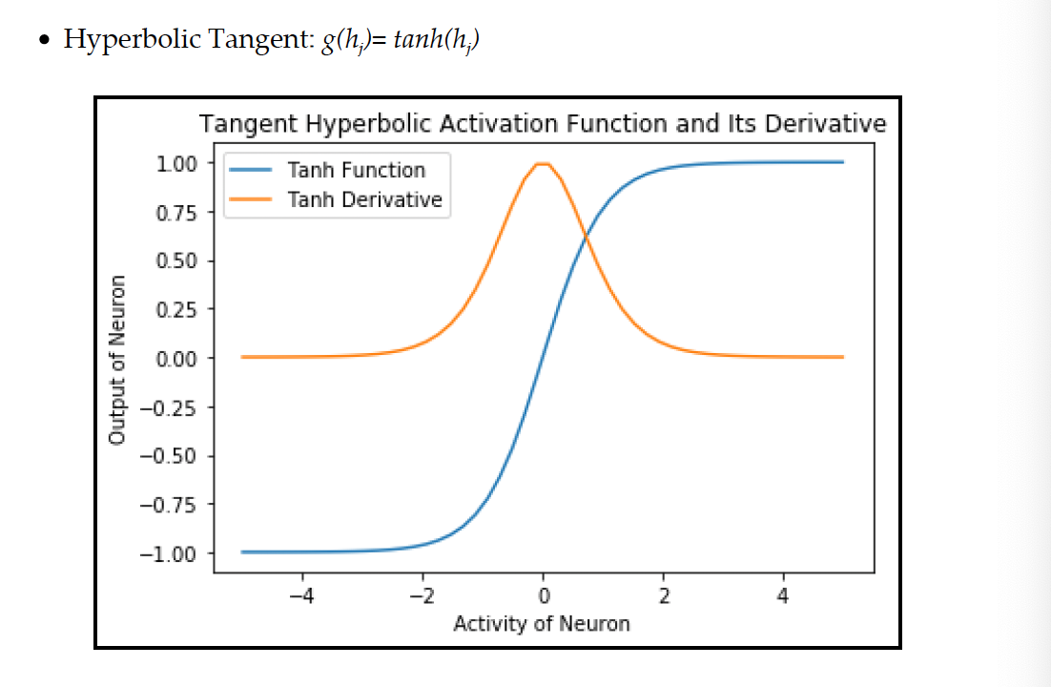
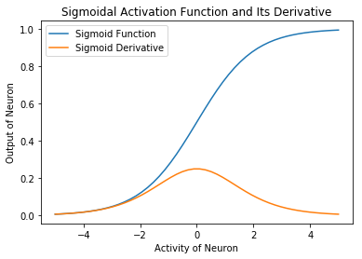

Slide 10
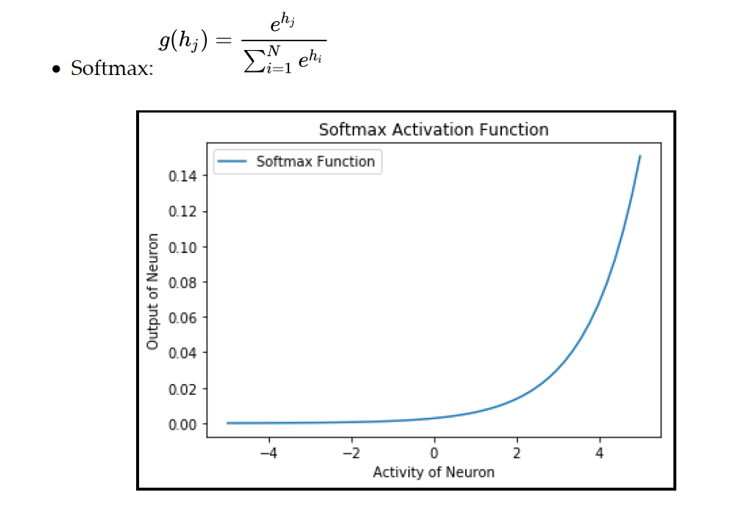
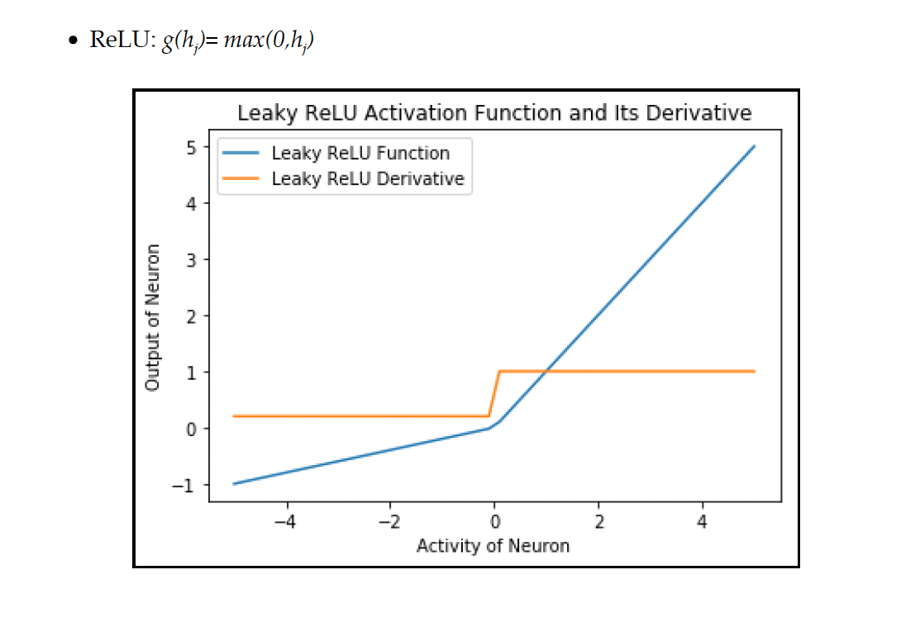

Slide 11
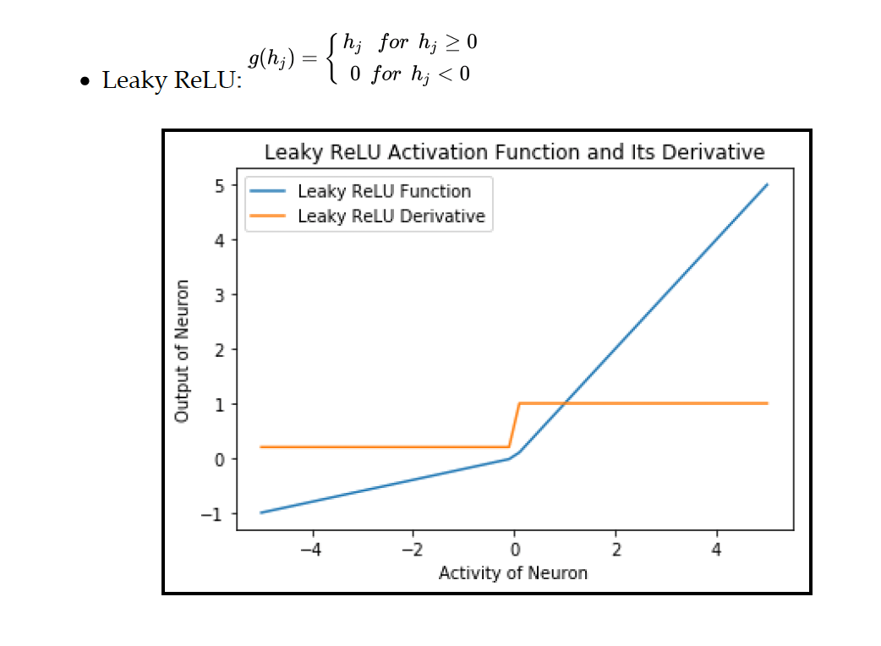
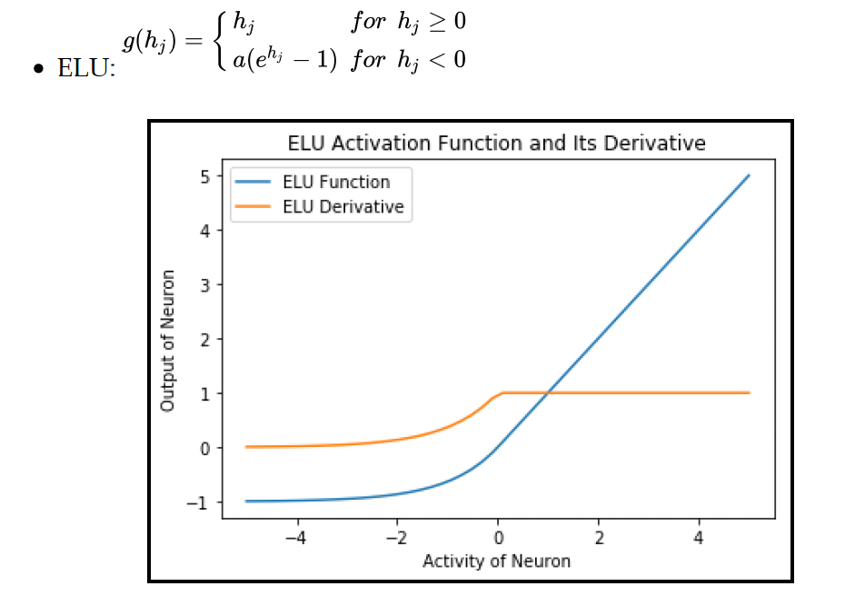

Slide 12
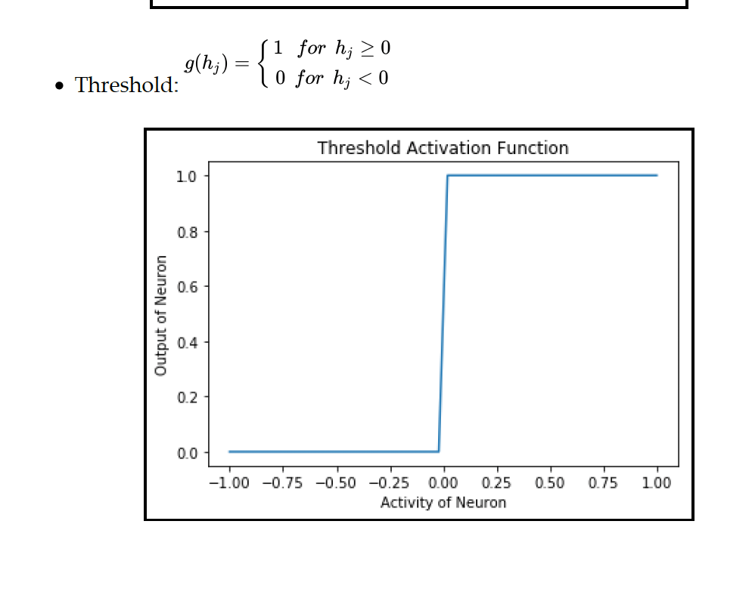

Slide 13
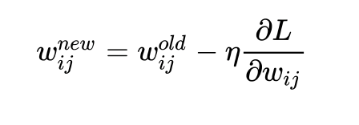
Modelling single neuron in TensorFlow
The process of learning involves adapting the weights such that a predefined loss function (L) reduces.
If we update the weights in the direction opposite to the gradient of the loss function with respect to weights, it will ensure that loss function decreases with each update – Gradient descent algorithm
Learning rate parameter:
Learning rate parameter determines how fast we descent the gradient.
It lies between 0 and 1
If learning rate is too high, the network may either oscillate around the correct solution or completely diverge from the solution.
On the other hand, when learning rate is too low, it will take a long time to converge to the solution finally.

Slide 14
Activation Function
The activation function decides how the output of the neuron varies with its activity.
Since the weight update equation involves a derivative of the loss function, which in turn will depend on the derivative of the activation function, we prefer a continuous-differentiable function as the activation function for the neuron.
Initially, sigmoid and hyperbolic tangent were used, but they suffered from slow convergence and vanishing gradients.
In recent years, RELU and its variants such as leaky ReLU and ELU are preferred since they offer fast convergence and at the same time, help in overcoming the vanishing gradient problem.
In ReLU, we sometimes have a problem of dead neurons, that is some neurons never fire because their activity is always less than zero, and hence, they never learn.
Both leaky ReLU and ELU overcome the problem of dead neurons by ensuring a nonzero neuron output, even when the activity is negative.

Slide 15
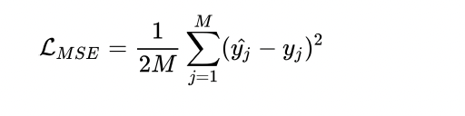
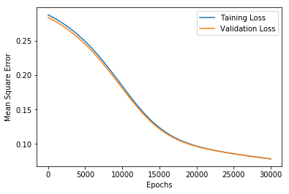
Loss Function:
Loss function is the parameter our network tries to minimize, and so choosing the right loss function is crucial for the learning.
M is the total number of training sample.

Slide 16
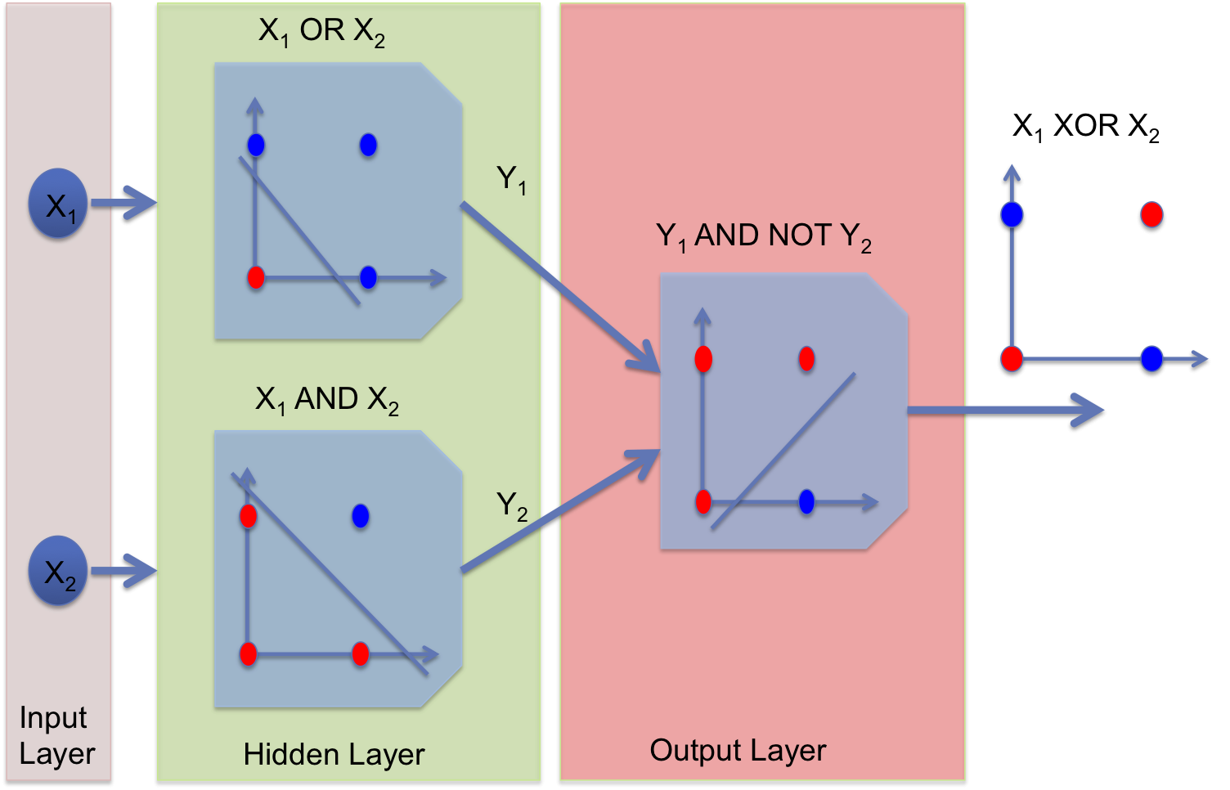
Multilayered perceptrons for regression and classification

Slide 17
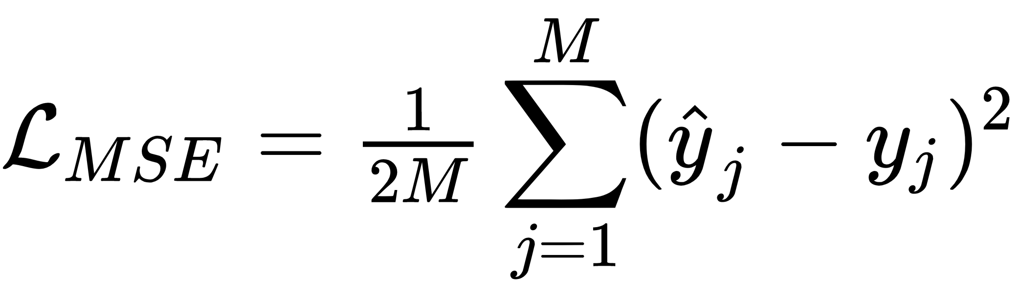
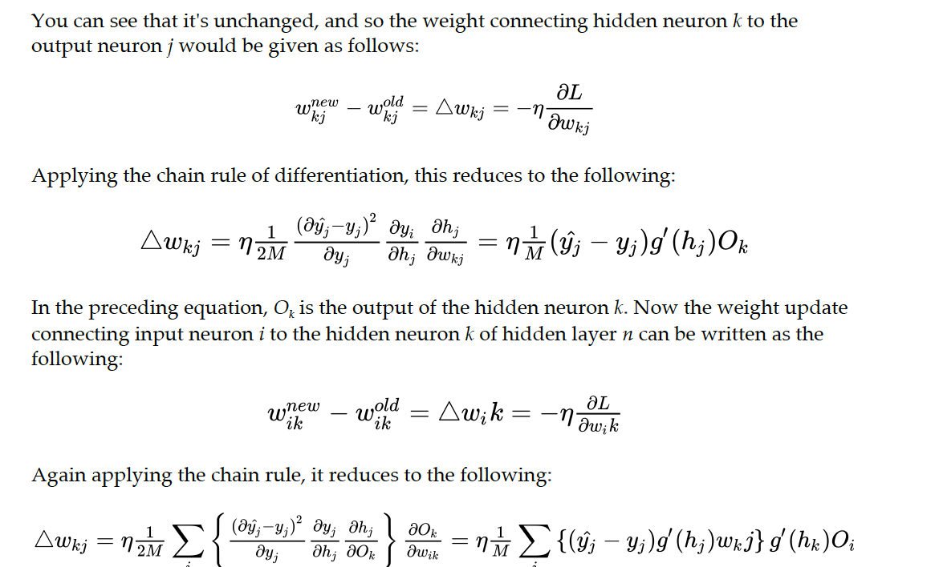
Backpropagation algorithm

Slide 18
STEPS INVOLVED IN BACK PROPAGATION
1. Apply the input to the network
2. Propagate the input forward and calculate the output of the network
3. Calculate the loss at the output, and then using the preceding expressions, calculate weight updates for output layer neuron
4. Using the weighted errors at output layers, calculate the weight updates for
hidden layer
5. Update all the weights
6. Repeat the steps for other training examples

Slide 19
Convolutional neural networks
Different layers of CNN
Convolution layers,
Pooling layers, and
Fully connected layers.
The convolution layer
This is the core building block of CNNs.
It performs the mathematical operation similar to convolution (cross-correlation to be precise) on its input, normally a 3D image. It's defined by kernels (filters).
The basic idea is that these filters stride through the entire image and extract specific features from the image.

Slide 20
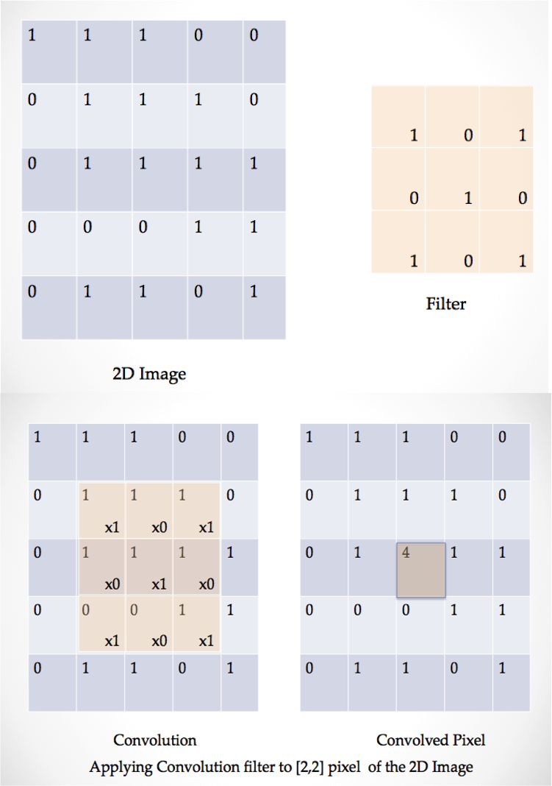

Slide 21
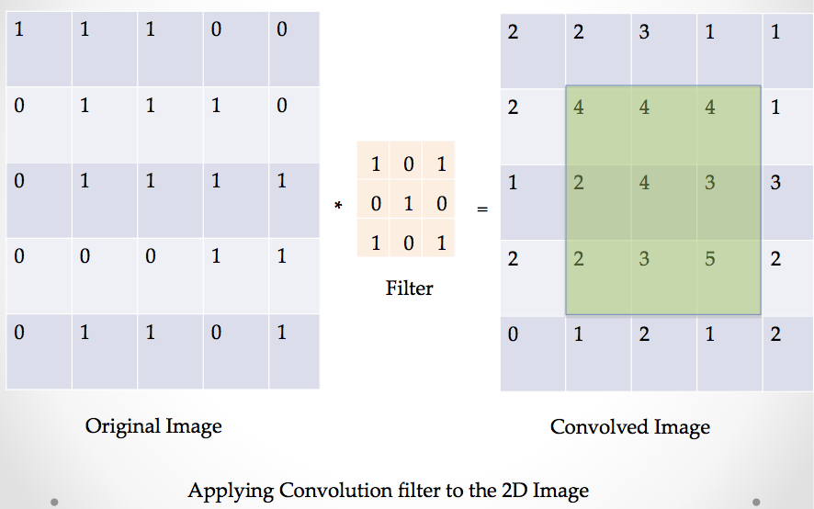
Important parameters
The size of the filters (kxk)
The number of filters in the layer – channels
The number of pixels the filter strides (s) through the image
The padding to be used while convolving. Traditionally, there are two options, either valid or same

Slide 22
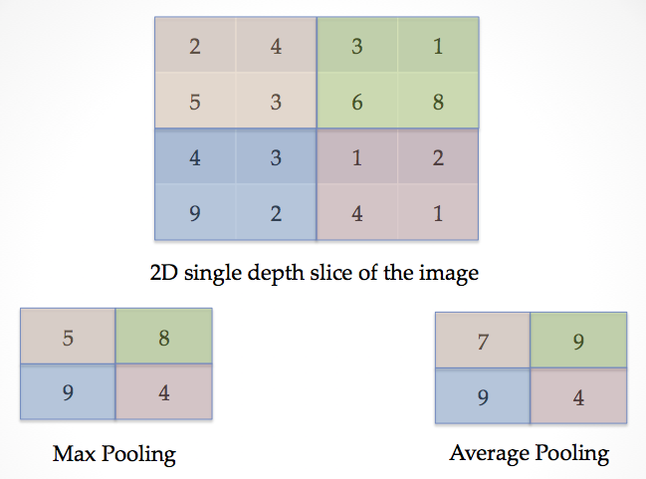
Pooling layer
The convolution layer is followed conventionally by a pooling layer.
The purpose of the pooling layer is to progressively reduce the size of the representation, and thus, reduce the number of parameters and computations in the network.
Thus, it down samples the information as it propagates through the network in feed forward manner.

Slide 23
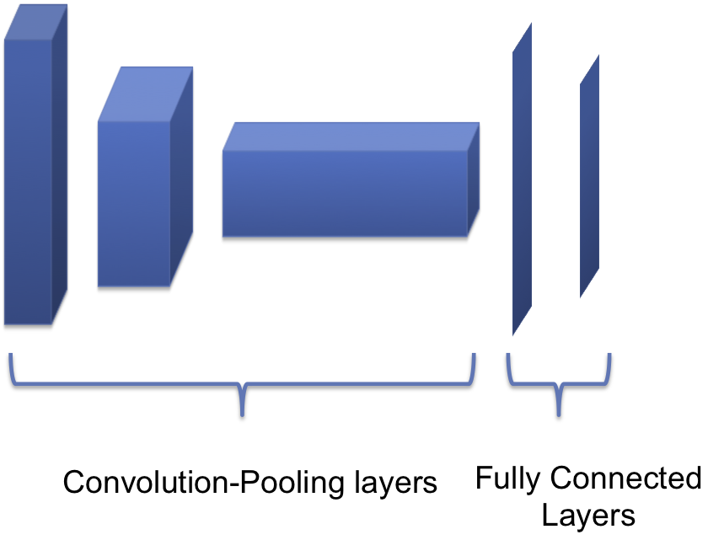
The basic architecture of a CNN network

Slide 24
Popular CNN model
Lenet:
LeNet was the first successful CNN applied to recognize handwritten digits. It was developed by Yann LeCun in the 1990s.
VGGnet:
This was the runner-up in ILSVRC 2014, developed by Karen Simonyan and Andrew Zisserman. Its first version contains 16 Convolution+FC layers and was called VGG 16.
Resnet:
Developed by Kaiming He et al., ResNet was the winner of ILSVRC 2015. It made use of new feature called residual learning and batch normalization.
It's a very deep network with more than 100 layers.
It's known that adding more layers will improve the performance, but adding layers also introduced the problem of vanishing gradients.
ResNet solved this issue by making use of identity shortcut connection, where the signal skips one or more layers.
Googlenet:
This was the winning architecture of ILSVRC 2014.
It has 22 layers, and introduced the idea of inception layer.
The basic idea is to cover a bigger area, while at the same time, keep a fine resolution for small information on the images.
As a result instead of one size filters, at each layer, we have filter ranging from 1x1 to 5x5 .
The result of all the filters are concatenated and passed to next layer, the process is repeated in the next inception layer

Slide 25
Recurrent neural networks
Recurrent Neural Network(RNN) is a type of Neural Network where the output from the previous step is fed as input to the current step.
In traditional neural networks, all the inputs and outputs are independent of each other, but in cases when it is required to predict the next word of a sentence, the previous words are required and hence there is a need to remember the previous words.
Thus RNN came into existence, which solved this issue with the help of a Hidden Layer.
The main and most important feature of RNN is its Hidden state, which remembers some information about a sequence. The state is also referred to as Memory State since it remembers the previous input to the network.
It uses the same parameters for each input as it performs the same task on all the inputs or hidden layers to produce the output.
This reduces the complexity of parameters, unlike other neural networks.

Slide 26
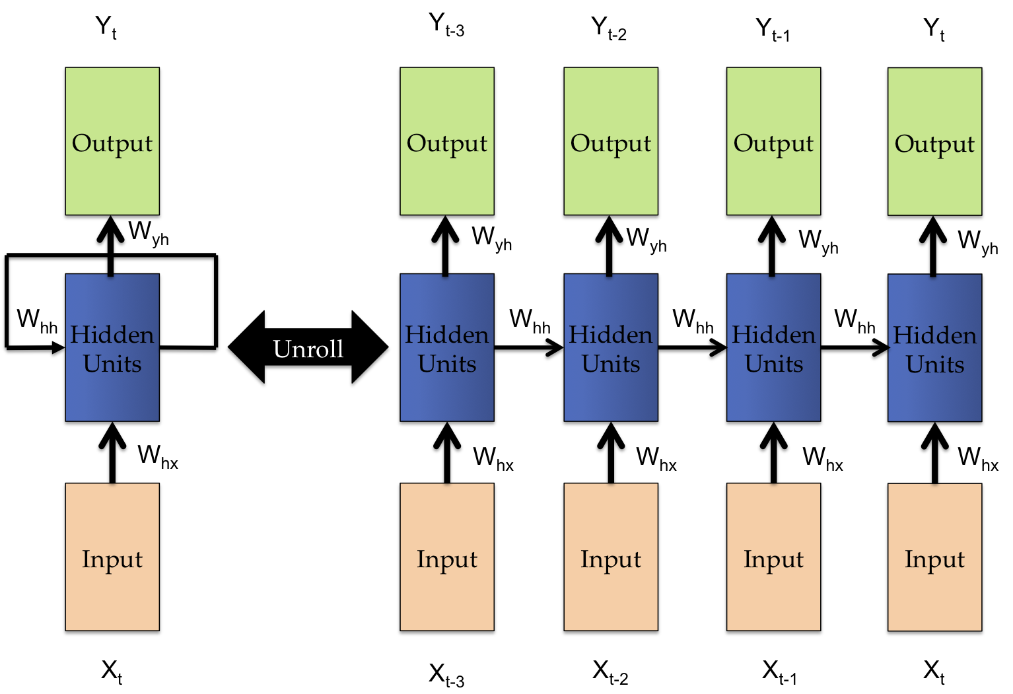
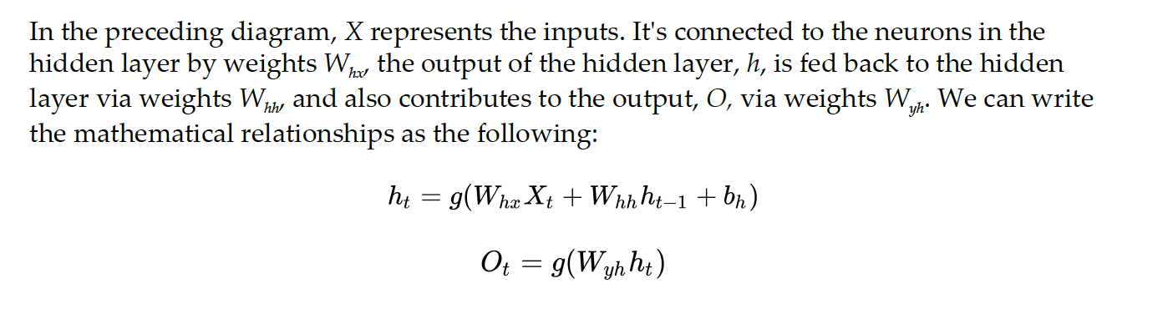

Slide 27
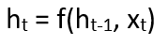
How RNN works
The Recurrent Neural Network consists of multiple fixed activation function units, one for each time step.
Each unit has an internal state which is called the hidden state of the unit. This hidden state signifies the past knowledge that the network currently holds at a given time step.
This hidden state is updated at every time step to signify the change in the knowledge of the network about the past.
The formula for calculating the current state:
where:
h_{t} -> current state h_{t-1} -> previous state x_{t} -> input state

Slide 28
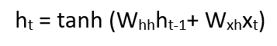
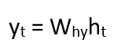
Formula for applying Activation function(tanh):
where:
w_{hh} -> weight at recurrent neuron w_{xh} -> weight at input neuron
The formula for calculating output:
Y_{t} -> output W_{hy} -> weight at output layer
These parameters are updated using Backpropagation. However, since RNN works on sequential data here we use an updated backpropagation which is known as Backpropagation through time.

Slide 29
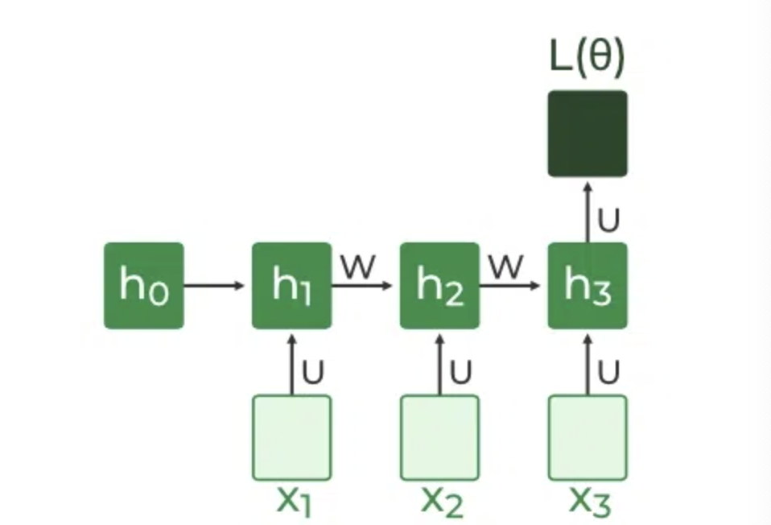
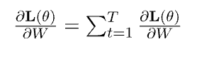
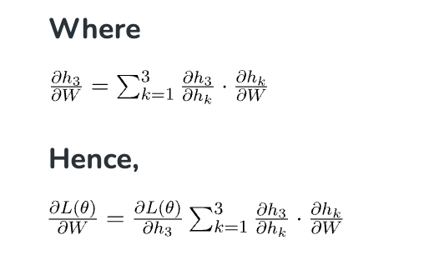
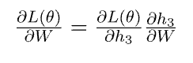
Backpropagation Through Time (BPTT)
In RNN the neural network is in an ordered fashion and since in the ordered network each variable is computed one at a time in a specified order like first h1 then h2 then h3 so on. Hence we will apply backpropagation throughout all these hidden time states sequentially.
L(θ)(loss function) depends on h3
h3 in turn depends on h2 and W
h2 in turn depends on h1 and W
h1 in turn depends on h0 and W
where h0 is a constant starting state.

Slide 30
Advantages of Recurrent Neural Network
An RNN remembers each and every piece of information through time. It is useful in time series prediction only because of the feature to remember previous inputs as well. This is called Long Short Term Memory.
Recurrent neural networks are even used with convolutional layers to extend the effective pixel neighborhood.
Disadvantages of Recurrent Neural Network
Gradient vanishing and exploding problems.
Training an RNN is a very difficult task.
It cannot process very long sequences if using tanh or relu as an activation function.

Slide 31
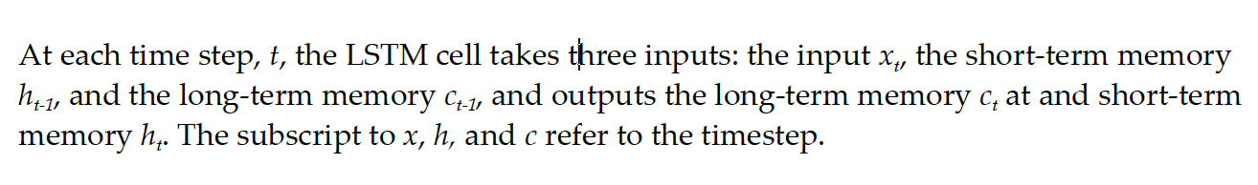
Long short-term memory
Hochreiter and Schmidhuber in 1997 proposed a modified RNN model, called the LSTM as a solution to overcome the vanishing gradient problem.
The hidden layer in the RNNs is replaced by an LSTM cell.
The LSTM cell consists of three gates: forget gate, input gate, and the output gate.
These gates control the amount of long-term memory and the short-term memory generated and retained by the cell.
The gates all have the sigmoid function which squashes the input between 0 and 1.

Slide 32
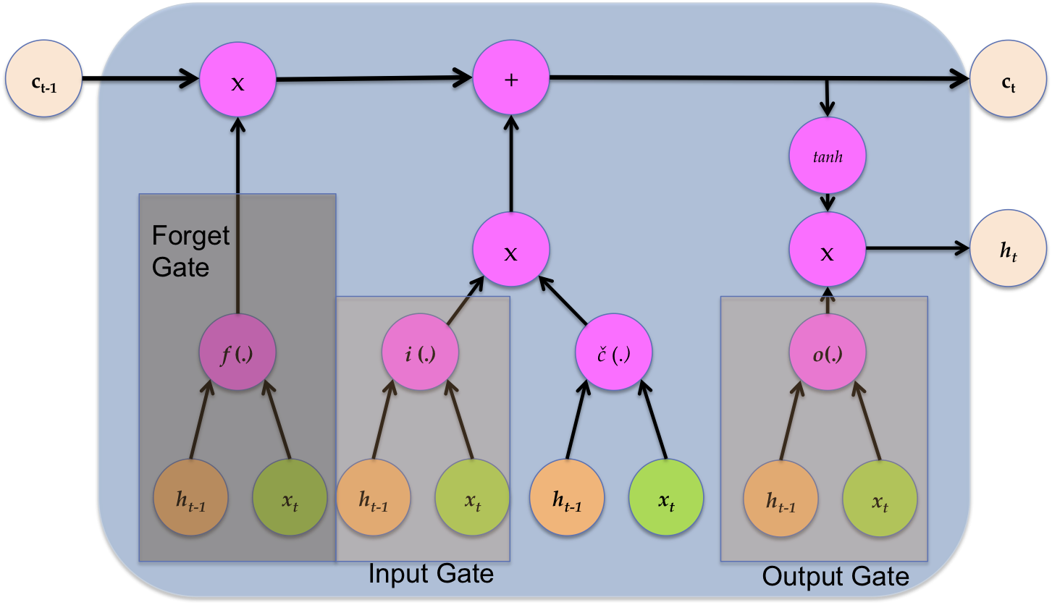

Slide 33
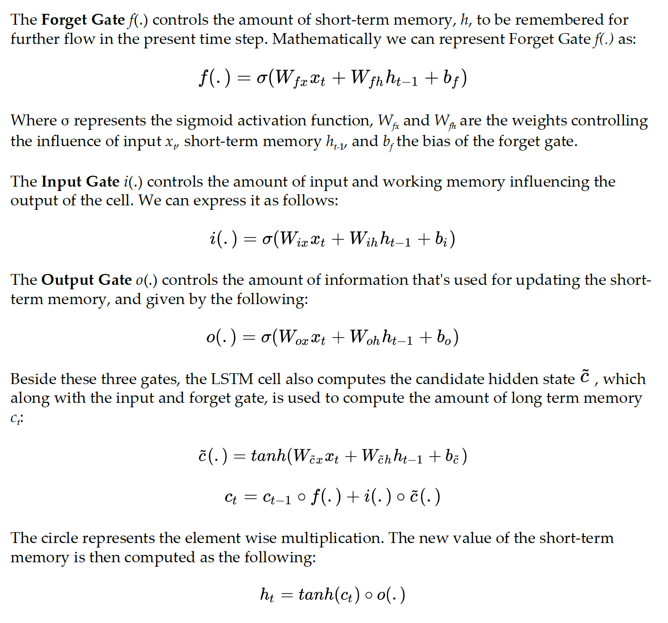

Slide 34
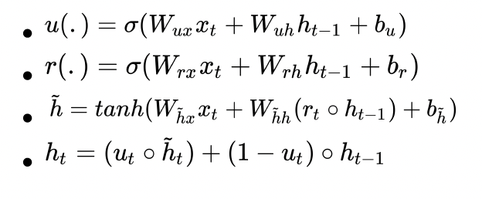
Gated recurrent unit
GRU is another modification of RNN. It has a simplified architecture compared to LSTM and overcomes the vanishing gradient problem.
It takes only two inputs, the input x_{t} at time t and memory h_{t-1} from time t-1.
There are only two gates: Update gate and Reset Gate.
The update gate controls how much previous memory to keep, and the reset gate determines how to combine the new input with previous memory.
We can define the complete GRU cell by the following four equations:

Slide 35
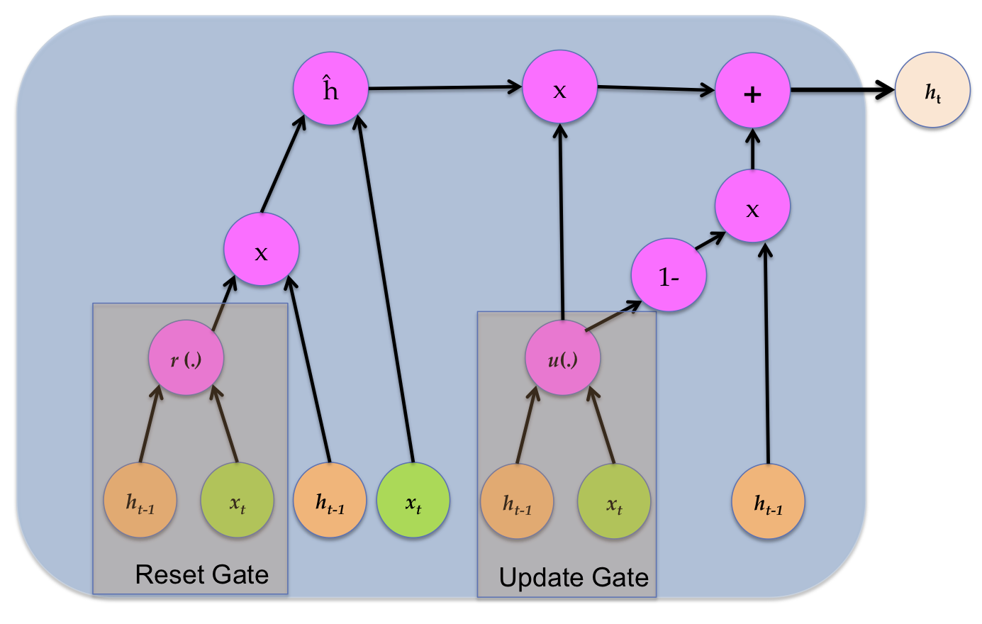

Slide 36
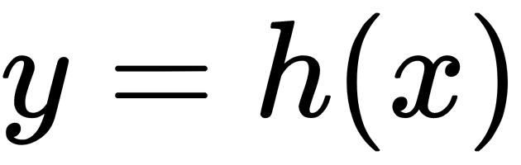
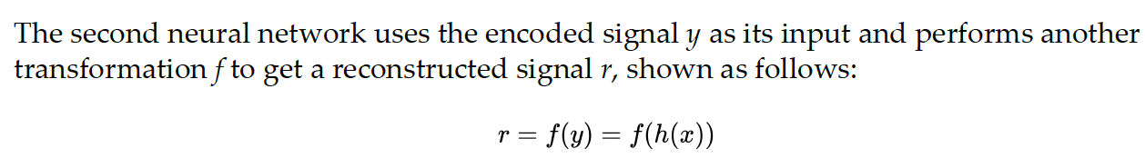
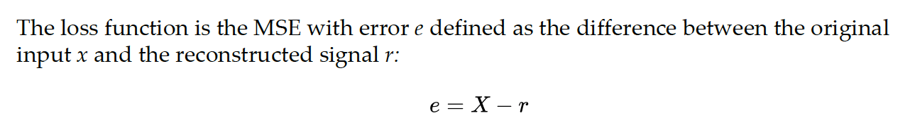
Autoencoders
Autoencoders are feedforward, non-recurrent neural network, and learn through unsupervised learning.
The autoencoder basically consists of two cascaded neural networks—the first network acts as an encoder; it takes the input x and encodes it using a transformation h to encoded signal y shown in the following equation:

Slide 37
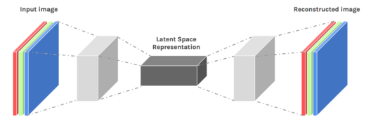
Autoencoders
Autoencoders are designed to reproduce their input, especially for images.
Key point is to reproduce the input from a learned encoding.
https://www.edureka.co/blog/autoencoders-tutorial/

Slide 38
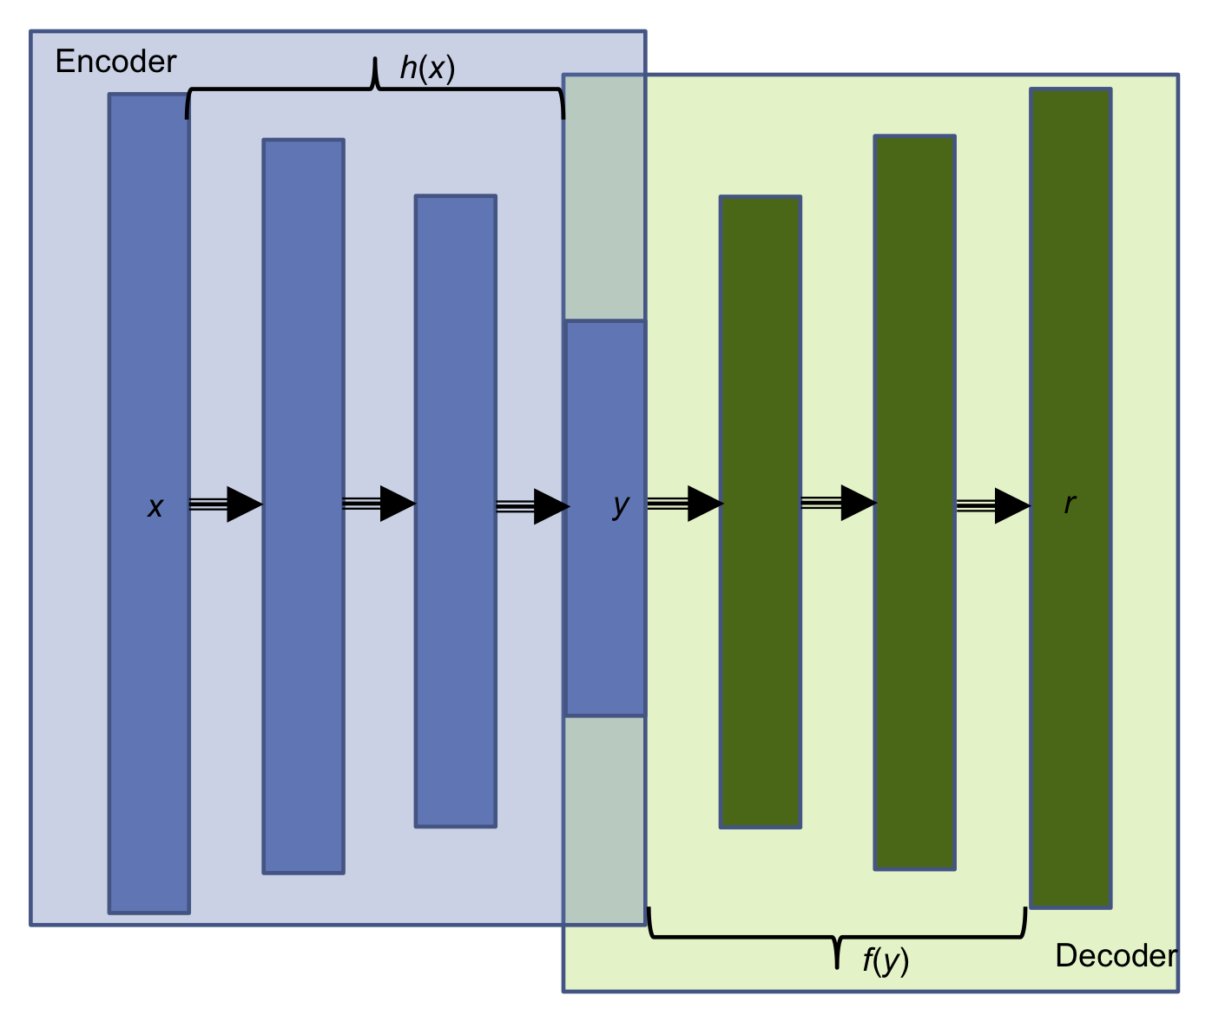

Slide 39
Autoencoders may have weight sharing, that is, weights of decoder and encoder are shared.
This is done by simply making them a transpose of each other; this helps the network learn faster as the number of training parameters is less.
There are a large variety of autoencoders for example: sparse autoencoders, denoising autoencoders, convolution autoencoders, and variational autoencoders.
Denoising Autoencoders
A denoising autoencoder learns from a corrupted (noisy) input; we feed the encoder network the noisy input and the reconstructed image from the decoder is compared with the original denoised input.
The idea is that this will help the network learn how to denoise an input.
The network does not just make a pixel-wise comparison, instead, in order to denoise the image, the network is forced to learn the information of neighboring pixels as well.
Once the autoencoder has learned the encoded features, we can remove the decoder part of the network and use only the encoder part to achieve dimensionality reduction.
The dimensionally reduced input can be fed to some other classification or regression model.

Slide 40
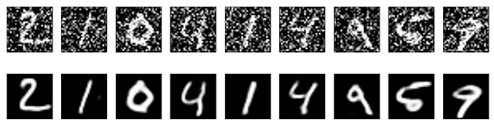
Denoising autoencoders
Basic autoencoder trains to minimize the loss between x and the reconstruction g(f(x)).
Denoising autoencoders train to minimize the loss between x and g(f(x+w)), where w is random noise.
Same possible architectures, different training data.
Kaggle has a dataset on damaged documents.
https://blog.keras.io/building-autoencoders-in-keras.html

Slide 41
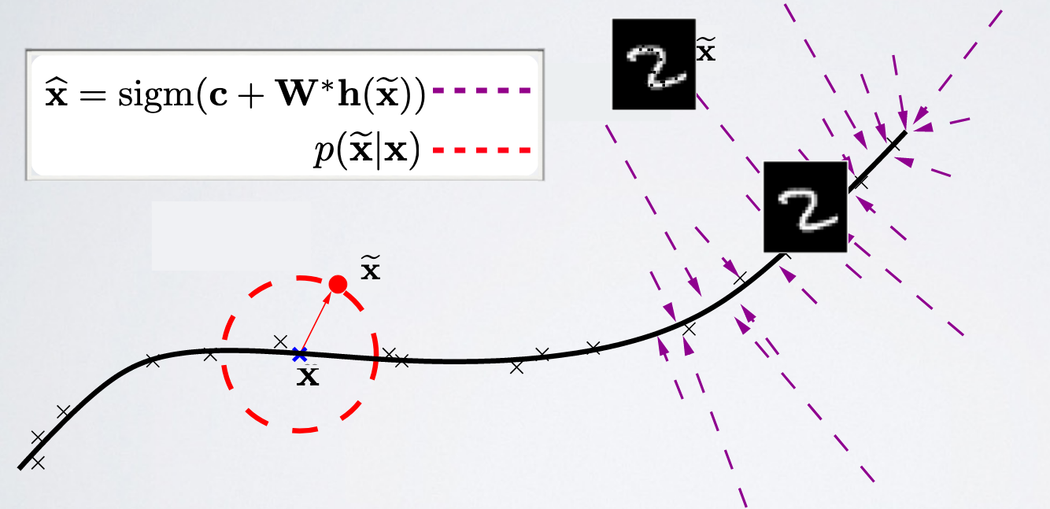
Denoising autoencoders
Denoising autoencoders can’t simply memorize the input output relationship.
Intuitively, a denoising autoencoder learns a projection from a neighborhood of our training data back onto the training data.
https://ift6266h17.files.wordpress.com/2017/03/14_autoencoders.pdf

Slide 42
Variational Autoencoders
Another very popular autoencoder is Variational Autoencoders. They are a mix of DL and the Bayesian inference.
VAEs have an additional stochastic layer; this layer, after the encoder network, samples the data using a Gaussian distribution, and the one after the decoder network samples the data using Bernoulli's distribution.
VAEs can be used to generate images. VAEs allow one to set complex priors in the latent and learn powerful latent representations.

Slide 43
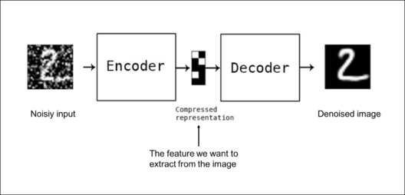
Autoencoders: applications
Denoising: input clean image + noise and train to reproduce the clean image.
https://www.edureka.co/blog/autoencoders-tutorial/

Slide 44
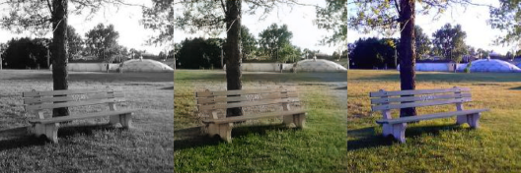
Autoencoders: Applications
Image colorization: input black and white and train to produce color images
https://www.edureka.co/blog/autoencoders-tutorial/

Slide 45

Autoencoders: Applications
Watermark removal
https://www.edureka.co/blog/autoencoders-tutorial/

Slide 46
Properties of Autoencoders
Data-specific: Autoencoders are only able to compress data similar to what they have been trained on.
Lossy: The decompressed outputs will be degraded compared to the original inputs.
Learned automatically from examples: It is easy to train specialized instances of the algorithm that will perform well on a specific type of input.
https://www.edureka.co/blog/autoencoders-tutorial/

Slide 47
Capacity
As with other NNs, overfitting is a problem when capacity is too large for the data.
Autoencoders address this through some combination of:
Bottleneck layer – fewer degrees of freedom than in possible outputs.
Training to denoise.
Sparsity through regularization.
Contractive penalty.

Slide 48
Bottleneck layer (undercomplete)
Suppose input images are nxn and the latent space is m < nxn.
Then the latent space is not sufficient to reproduce all images.
Needs to learn an encoding that captures the important features in training data, sufficient for approximate reconstruction.

Slide 49
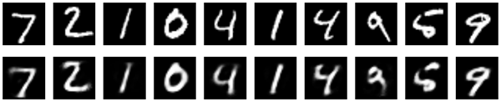
Simple bottleneck layer in Keras
input_img = Input(shape=(784,))
encoding_dim = 32
encoded = Dense(encoding_dim, activation='relu')(input_img)
decoded = Dense(784, activation='sigmoid')(encoded)
autoencoder = Model(input_img, decoded)
Maps 28x28 images into a 32 dimensional vector.
Can also use more layers and/or convolutions.
https://blog.keras.io/building-autoencoders-in-keras.html

